Slide 1

MSKAM
Sales Forecasting & Maintain Efficient Inventory

Slide 2



What is Data Science?
Data Science
Applying advanced statistical tools to existing data to generate new insights
Service Change
Converting new data insights into (often small) changes to business processes
Smarter Work
More efficient and effective use of staff and resources

Slide 3
Abstration
Product sales forecasting is a mojor aspect of purchasing management .
Forecasting are crucial in determining inventory stock levels , and accurately estimating future demand for goods
Sales forcasting for goods can be significant to ensure loss is minimized.
For creating a working prototype of our project idea we have used dataset available by Kaggle on Corporacion Favorita Grocery Sales Forecasting .
https://www.kaggle.com/c/favorita-grocery-sales-forecasting

Slide 4

Tap this inaccessible data
for our software

Slide 5
Aim
Creating a Graphical User Interface Software for small retail , wholesale shops for sales forcasting.
Proving a range for maintain a stock for a specific product for a given interval so that the profit maximizes.
For doing an analysis ,we develop a machine learning model to forecast the sale of the shop.

Slide 6
Introduction
Forecasts product sales based on the items, stores, transaction and other dependent variables like holidays and oil prices.
We have analyzed the data as a supervised learning problem.
In order to forecasts the sales we have compared different regression models like Linear Regression , Random Forest .
The data comes in the shape of multiple files. First, the training data (train.csv) essentially contains the sales by date, store, and item. The test data (test.csv) contains the same features without the sales information, which we are tasked to predict. The train vs test split is based on the date. In addition, some test items are not included in the train data.

Slide 7
Technology Stack
Importing CSV files using Pandas
Pandas
Keras
Numpy
Matplotlib
seaborn
scipy
Sklearn
XGboost
MYSQL
Database
Tkinter
SQLite Database
CSV import – export
Exporting database into CSV files
GUI Interface for Billing Application
Sales Forecasating Using Machine Learning

Slide 8
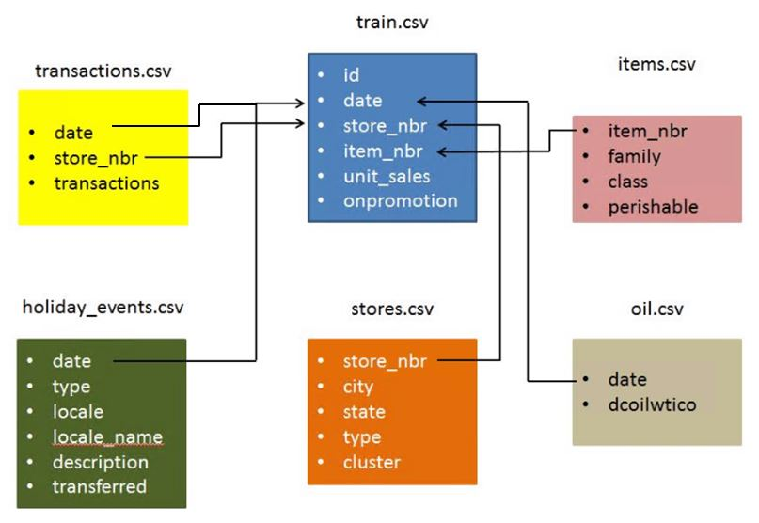
Understanding the Dataset

Slide 9
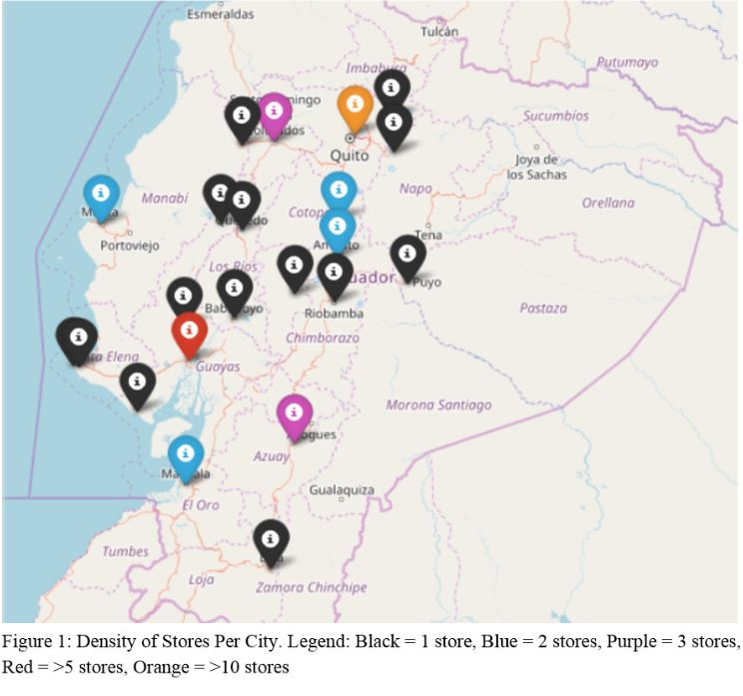
Stores in Ecuador

Slide 10
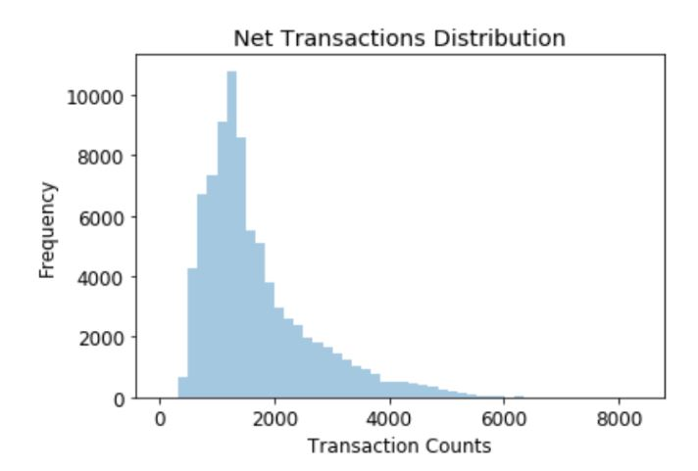
Data Exploration for Further Analysis

Slide 11
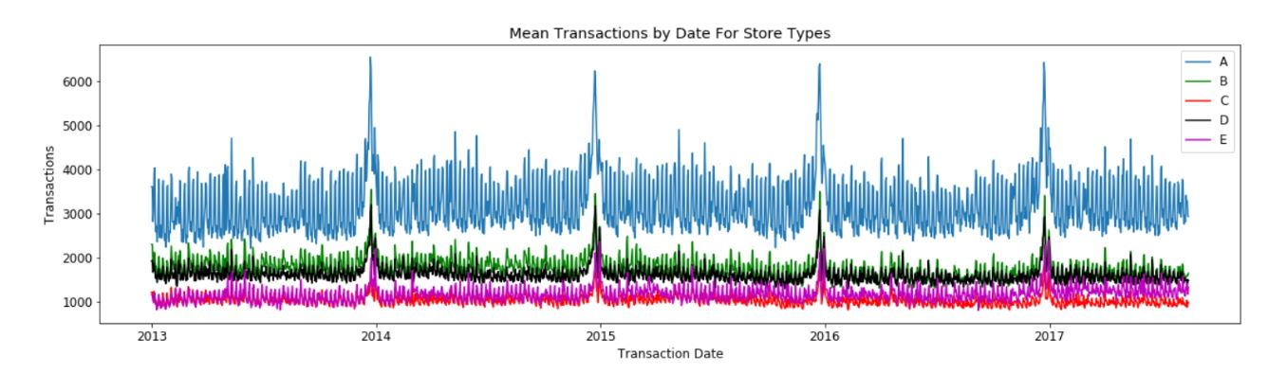
Data Exploration for Further Analysis

Slide 12
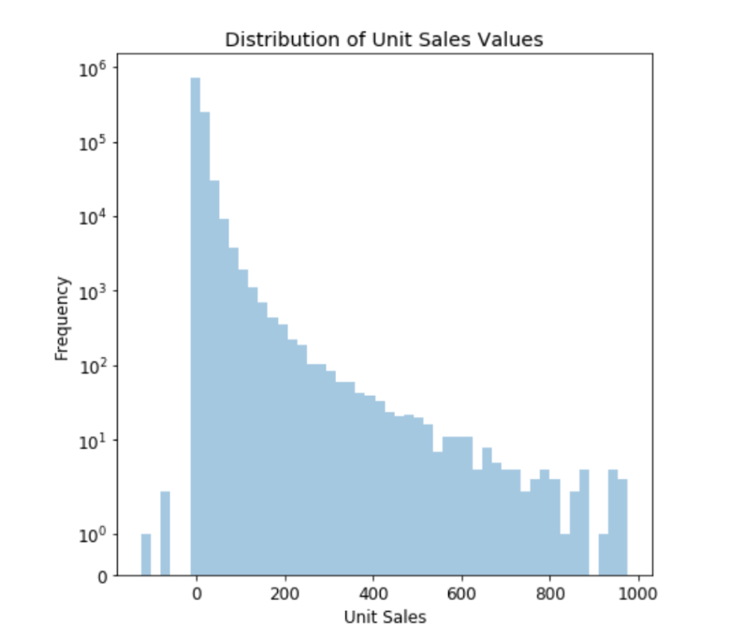
Data Exploration for Further Analysis

Slide 13
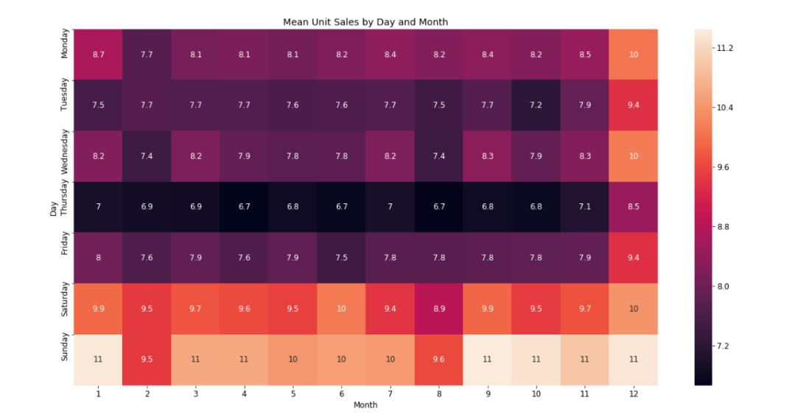
Data Exploration for Further Analysis

Slide 14
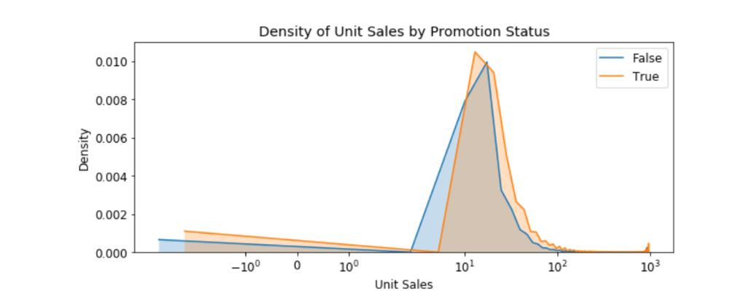
Data Exploration for Further Analysis

Slide 15
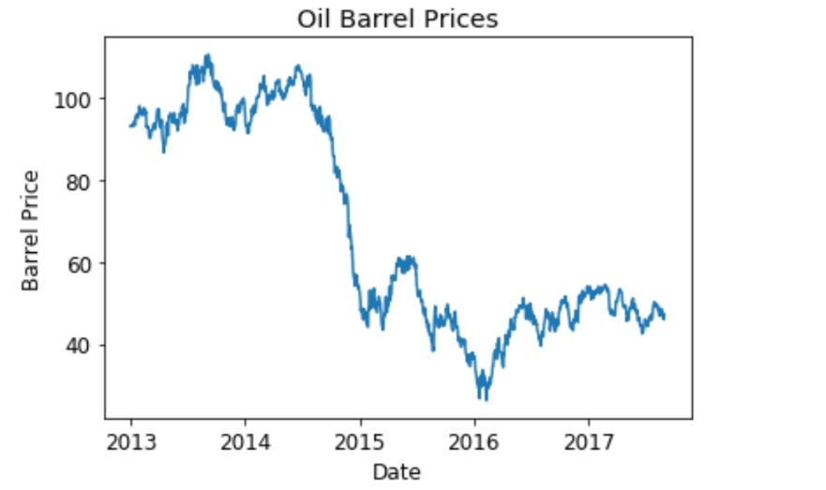
Data Exploration for Further Analysis

Slide 16
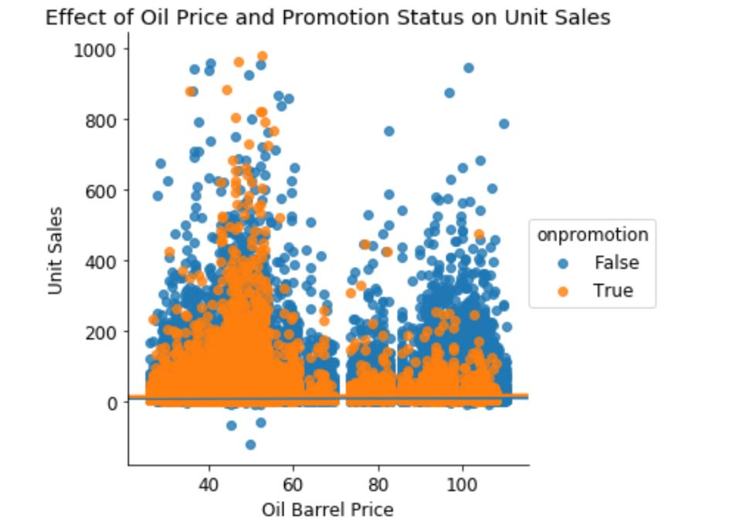
Data Exploration for Further Analysis

Slide 17
Methodology
Data Preprocessing
Data loading
Anomoly Detection
Data Preparation and Data Cleaning
Finding Dependent Variables
Fetching Product Purchase Trend
Counting products sold for a time Interval
Exploratory Data Analysis
Data Transformation
One Hot Encoding

Slide 18
Various Models to Deploy
Regression Techniques
Linear Regression
Decision Tree Regression
Random Forest Regression
Gradient Boosting Regression
Light Gradient Boosting Method (LGBM)

Slide 19
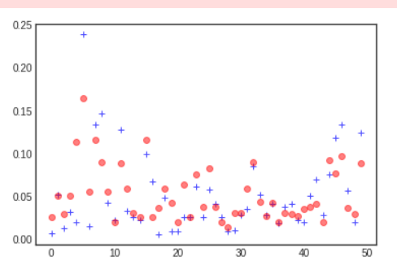
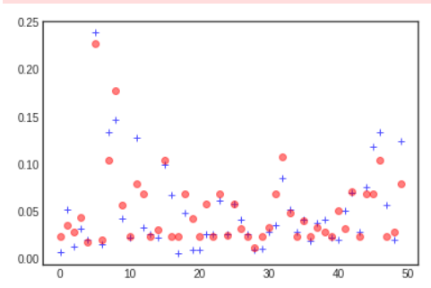
Plots After Prediction
Decision tree plot
Extra Tree regressor Plot

Slide 20
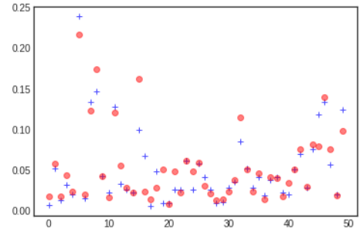
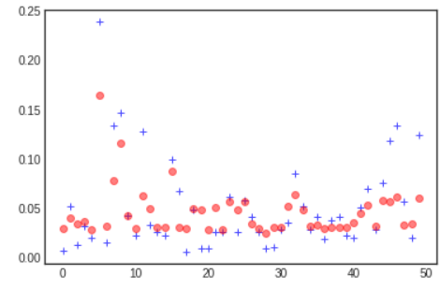
Plots After Prediction
Random Forest plot
Gradient Boost plot

Slide 21
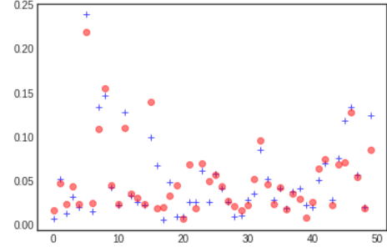
Plots After Prediction
XG BOOST Plot

Slide 22
Accuracy of various models based on RMSE
 | Model Name | Root Mean Square Value
1 | Extra Tree Regressor | 0.031669213835962835 / 0.0
2 | Random Forest Regressor | 0.025754442870200338 / 0.0
3 | Fradient Boosting | 0.0254620285431131 / 0.0
4 | XG Boost | 0.02505748758471952 / 0.0

Slide 23
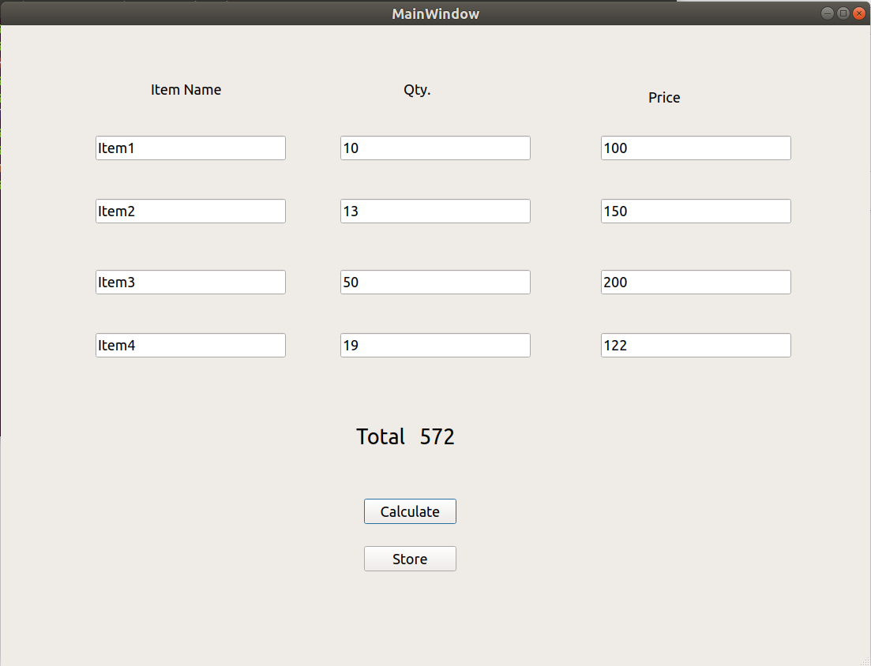
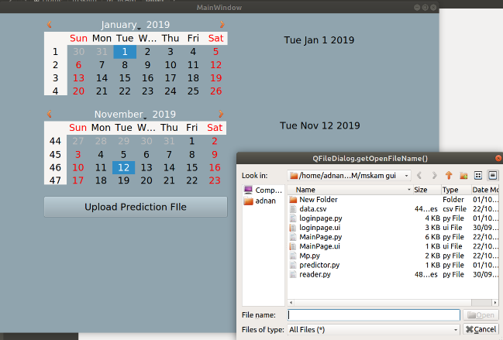
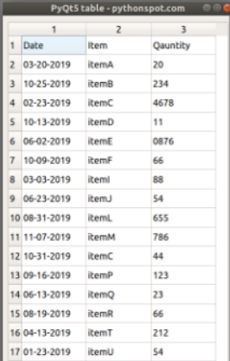
GUI of MSKAM Software

Slide 24
Future Enhancements
Dynamic Graphical User Interface for better understanding.
Research on algorithms and models for improving the efficiency, hence minimizing the Company’s Inventory maintenance cost.
Online billing system for Shopping Marts and local vendors so that real time data could be stored and be used for further predictions.
Neural Network implementation.

Slide 25
THANKYOU

